Slide 1



Internship Application & Progress Monitoring System
DBMS Project — Phase 1 / Review 1
Presenter: Martala Harsha Vardhan Reddy | Roll No: 25WU0102152
School of Technology, Woxsen University
Notes:
1

Slide 2
Problem Statement & Objectives
❌ Current State — Manual Tracking
✅ Proposed Solution — Centralized RDBMS
  Fragmented spreadsheets with no centralized visibility
  No real-time status updates for students or faculty
  High risk of data inconsistency and loss
  No audit trail for applications or progress
  Single relational database for all internship lifecycle data
  Real-time tracking of applications, placements, and progress
  Role-based access ensuring data integrity and security
  Automated referential integrity and audit logging
Notes:
2

Slide 3
System Scope & User Roles
Four distinct actors interact with the system, each with clearly scoped permissions.
Student
Company
Register, browse postings, submit applications, and upload weekly progress reports.
Post openings, review applications, and update selection status.
Faculty Mentor
Admin
Monitor assigned students, review reports, and submit evaluations.
Manage users, postings, and system-wide configurations with full oversight.
Notes:
3

Slide 4

Key Entities & Primary Attributes
Entity
Primary Key
Key Attributes
Foreign Keys
Student
student_id
name, email, program, semester
—
Company
company_id
name, industry, location, contact
—
Faculty_Mentor
faculty_id
name, department, email
—
Internship_Posting
posting_id
title, description, duration, stipend
company_id
Application
application_id
status, applied_date, resume_url
student_id, posting_id
Internship_Record
record_id
start_date, end_date, final_status
application_id, faculty_id
Progress_Report
report_id
week_num, description, rating
record_id
Notes:
4

Slide 5
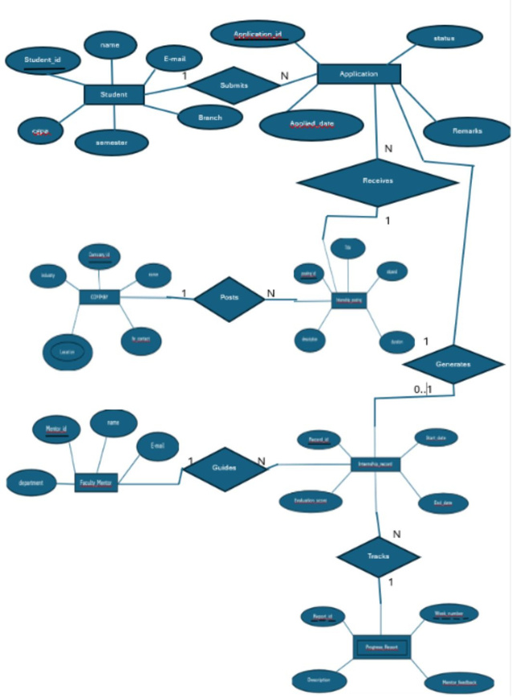
Entity-Relationship (ER) Diagram
Relationship Summary
  Student → Application: 1:N — one student submits many applications
  Company → Posting: 1:N — one company posts many openings
  Posting → Application: 1:N — one posting receives many applications
  Application → Record: 1:0..1 — only accepted applications generate a record
  Faculty → Record: 1:N — one mentor guides many students
  Record → Report: 1:N — one internship tracks many weekly reports
Notes:
5

Slide 6
Relationships & Cardinality Rules
Student → Application (1:N)
Company → Internship_Posting (1:N)
Application → Internship_Record (1:0..1)
Each student may submit multiple applications; student_id is a foreign key in Application.
A company can post multiple openings; company_id is referenced in Internship_Posting.
Only accepted applications generate a record; application_id is a unique foreign key.
Faculty_Mentor → Internship_Record (1:N)
Internship_Record → Progress_Report (1:N)
One faculty member guides multiple students; faculty_id is a foreign key in Internship_Record.
Each internship tracks multiple weekly reports; record_id cascades on delete.
Notes:
6

Slide 7

Relational Schema & Foreign Key Constraints
Table
Primary Key
Foreign Key
Referential Action
Application
application_id
student_id → Student
ON DELETE RESTRICT
Application
application_id
posting_id → Internship_Posting
ON DELETE CASCADE
Internship_Posting
posting_id
company_id → Company
ON DELETE SET NULL
Internship_Record
record_id
application_id → Application
ON DELETE CASCADE
Internship_Record
record_id
faculty_id → Faculty_Mentor
ON DELETE SET NULL
Progress_Report
report_id
record_id → Internship_Record
ON DELETE CASCADE
CASCADE for child records; RESTRICT / SET NULL for core entities to preserve history.
Notes:
7

Slide 8
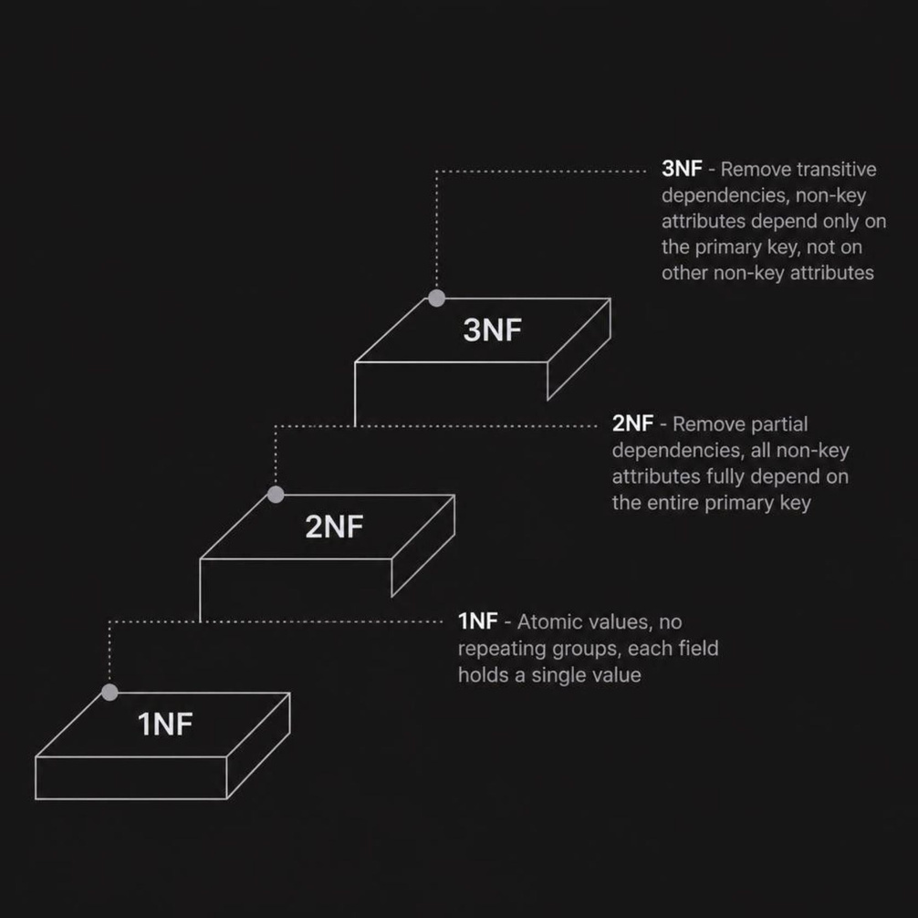
Database Normalization (1NF → 3NF)
Normalization Applied
  1NF: All attributes are atomic — no multi-valued fields in any entity.
  2NF: Composite keys eliminated; every non-key attribute depends on the full primary key.
  3NF: Transitive dependencies removed — e.g., company details are in Company, not duplicated in Internship_Posting.
Notes:
8

Slide 9

Expected Modules & Phase 2 Roadmap
SQL DDL Execution
Finalize and execute CREATE TABLE scripts with all constraints and indexes.
Sample Data Population
Insert realistic test data across all seven entities for query validation.
Complex Query Building
Develop JOIN, aggregation, and subquery reports for each user role.
Frontend Integration
Connect backend to a web interface for live system demonstration.
Notes:
9

